Slide 1
LABS ON AN IPV6-FIRST IXP
Operational Summary of the Labs: Backbone, L2VPN, L3VPN, and RFC8950

Slide 2
LABS COMPLETED
Backbone Overview
Lab 1 — L2VPN (EVPN + SRv6)
Lab 2 — L3VPN Dual-Stack (IPv4/IPv6)
Lab 3 — RFC8950 (IPv6 Next-Hop for IPv4 Routes)

Slide 3
Backbone — overview
General Design
  IPv6-first architecture for both links and routing.
  IS-IS used as the IGP, ensuring scalability for EVPN, combined with SRv6 as the data plane.
  BGP for overlay, handling SRv6 route distribution and managing both iBGP and eBGP sessions.

Slide 4
Backbone — Key Configurations
IPv6-first link setup, ensuring native IPv6 transport across all backbone interfaces.
IS-IS as the Interior Gateway Protocol (IGP), chosen for its scalability and native support for IPv6, especially in EVPN deployments.
Segment Routing over IPv6 (SRv6) used as the data plane, enabling simplified forwarding and service chaining.
BGP sessions (iBGP/eBGP) established for overlay routing, including SRv6 route advertisement and VPN service distribution.

Slide 5
Labs 1 — L2VPN+SRv6
Objective
  Validate an IPv6-first backbone for EVPN Layer 2 services over SRv6.
Key Points
  EVPN Instance Configuration: Use evpn vpn-instance with bd-mode, define bridge-domain, and assign an IPv4-based route distinguisher.
  Layer 2 Sub-interface: Configure sub-interfaces (e.g., GigabitEthernet0/1/10.100) with rewrite pop single to support VLAN-based forwarding.
  BGP Configuration: Under l2vpn-family evpn, enable advertisement with encapsulation type SRv6 using advertise encap-type srv6.

Slide 6
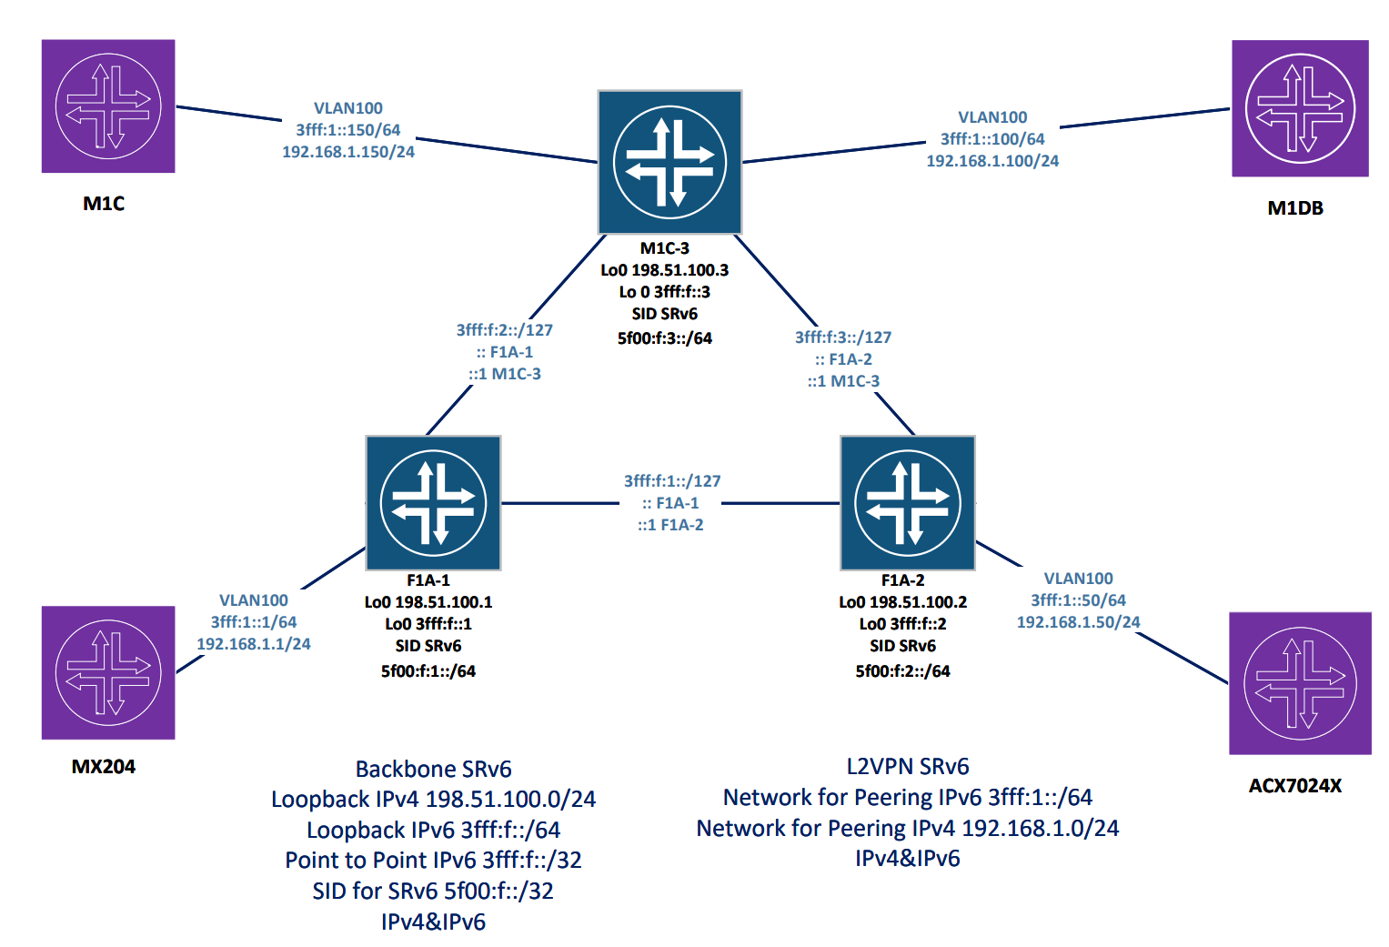

Slide 7
Code Snippets
evpn vpn-instance PRIVATE_L2VPN_100 bd-mode
route-distinguisher 198.51.100.1:100
segment-routing ipv6 locator srv6be
vpn-target 100:64500 export-extcommunity
vpn-target 100:64500 import-extcommunity
interface GigabitEthernet0/1/10
description "LINK MX-204 XE-0/1/1"
undo shutdown
undo dcn
interface GigabitEthernet0/1/10.100 mode l2
description "L2 VLAN 100"
encapsulation dot1q vid 100
rewrite pop single
bridge-domain 100
bridge-domain 100
evpn binding vpn-instance PRIVATE_L2VPN_100
bgp 64500
l2vpn-family evpn
policy vpn-target
peer 3FFF:F::2 enable
peer 3FFF:F::2 advertise encap-type srv6
peer 3FFF:F::3 enable
peer 3FFF:F::3 advertise encap-type srv6

Slide 8
Labs 2 — L3VPN+SRv6 (IPv4/IPv6)
Objective
  Multi-tenant Layer 3 platform (dual-stack) using EVPN as the control plane and SRv6 as the data plane.
Key Points
  vpn-instance configured with both ipv4-family and ipv6-family.
  L3 sub-interface .200 with assigned IP and IPv6 addresses (e.g., 203.0.113.1 / 3FFF:2:1::1).
  Advertise L2VPN EVPN within the VRF, using segment-routing locator srv6be evpn.

Slide 9
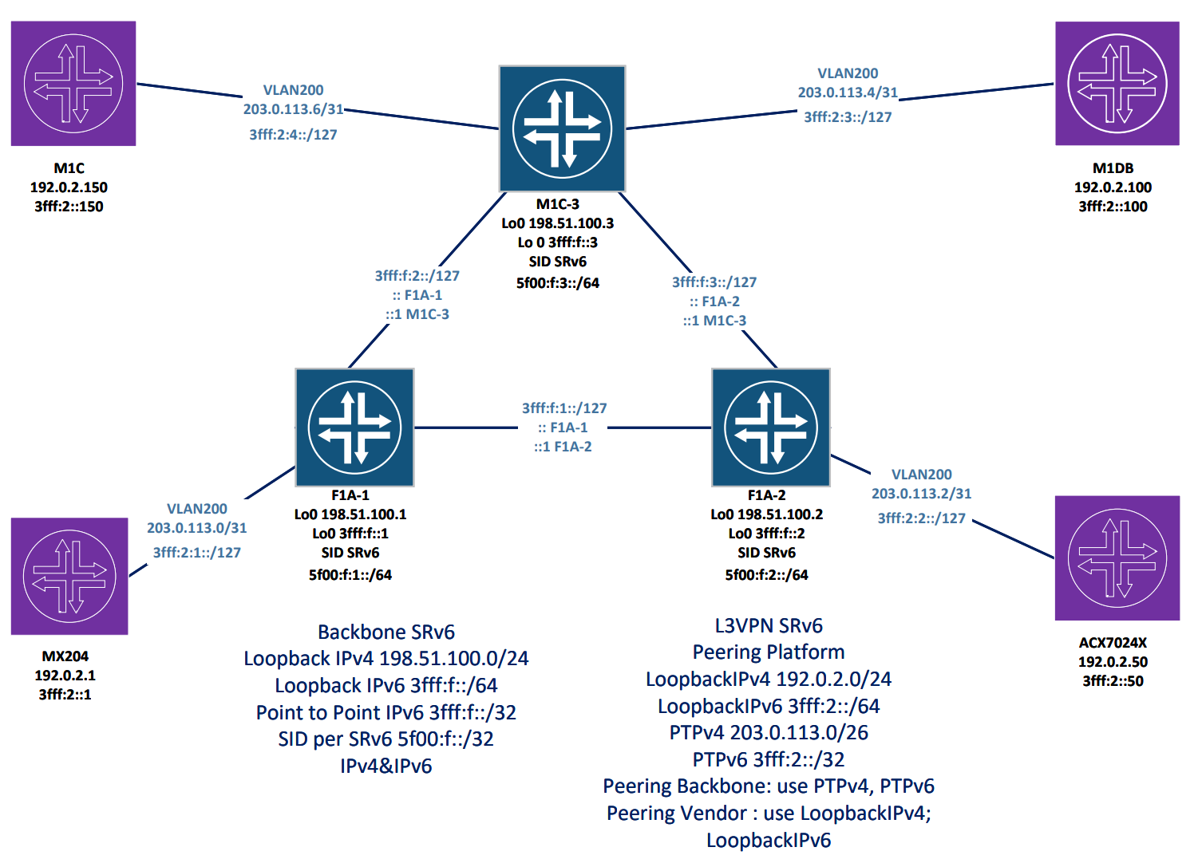

Slide 10
Code Snippets
ip vpn-instance PRIVATE_L3VPN_IPV4-IPV6_200
ipv4-family
route-distinguisher 198.51.100.1:200
apply-label per-instance
vpn-target 200:64500 export-extcommunity evpn
vpn-target 200:64500 import-extcommunity evpn
ipv6-family
route-distinguisher 198.51.100.1:200
apply-label per-instance
vpn-target 200:64500 export-extcommunity evpn
vpn-target 200:64500 import-extcommunity evpn
interface GigabitEthernet0/1/10.200
vlan-type dot1q 200
description "L3 VLAN 200"
ip binding vpn-instance PRIVATE_L3VPN_IPV4-IPV6_200
ipv6 enable
ip address 203.0.113.1 255.255.255.254
ipv6 address 3FFF:2:1::1/127
BGP
ipv4-family vpn-instance PRIVATE_L3VPN_IPV4-IPV6_200
import-route direct
advertise l2vpn evpn
segment-routing ipv6 locator srv6be evpn
segment-routing ipv6 best-effort evpn
peer 203.0.113.0 as-number 64501
peer 203.0.113.0 route-policy Peering_Point_Rule export
ipv6-family vpn-instance PRIVATE_L3VPN_IPV4-IPV6_200
import-route direct
advertise l2vpn evpn
segment-routing ipv6 locator srv6be evpn
segment-routing ipv6 best-effort evpn
peer 3FFF:2:1:: as-number 64501
peer 3FFF:2:1:: route-policy Peering_Point_Rule_ipv6 export

Slide 11
Labs 3 — RFC8950
Objective
  Implement IPv6 next-hop for IPv4 routes at an IXP using the extended-nexthop model.
  GitHub Repository —https://github.com/euro-ix/rfc8950-ixp
Key Points
  Routing Policy to set next-hop self on aggregated routes.
  BGP Group Configuration with family inet extended-nexthop and an IPv6 neighbor (e.g., 3fff:1::50).

Slide 12
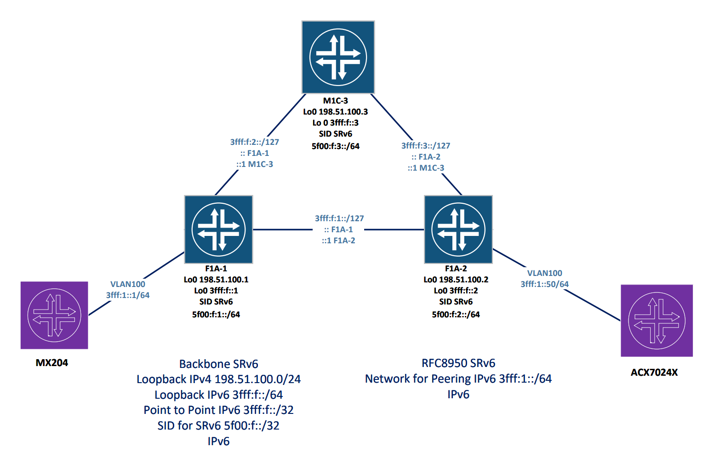

Slide 13
Code Snippets
interfaces {
xe-0/1/1 {
description "LINK F1A-1 GE 0/1/10";
flexible-vlan-tagging;
encapsulation flexible-ethernet-services;
gigether-options {
no-auto-negotiation;
speed 1g;
}
unit 100 {
description "L2 VLAN 100";
vlan-id 100;
family inet;
family inet6 {
address 3fff:1::1/64;
}
routing-options {
router-id 192.0.2.1;
autonomous-system 64501;
policy-options {
policy-statement NH-SELF {
then {
next-hop self;
}
}
policy-statement REJECT-ALL {
term default {
then reject;
}
}
}
protocols {
bgp {
group RFC8950 {
type external;
local-address 3fff:1::1;
family inet {
unicast {
extended-nexthop;
}
}
family inet6 {
unicast;
}
export [ NH-SELF REJECT-ALL ];
peer-as 64502;
local-as 64501;
neighbor 3fff:1::50;
}

Slide 14
RFC8950 — Vendor Limit
Adopted L2 Configuration
  The lab uses a Layer 2 setup for RFC8950.
  This choice was driven by vendor compatibility constraints.
Interoperability Issue
  Huawei devices are not supported in the lab’s GitHub repository.
Adopted Solution
  RFC8950 was implemented exclusively on Juniper routers. This enables functional testing of IPv6 next-hop for IPv4 routes.

Slide 15
Resilience & Troubleshooting
Implemented Best Practices
  BFD + FRR (TI-LFA) for fast failover and rapid convergence.
  Segment Routing for advanced traffic steering and enhanced network visibility.
  Use of VRF/EVPN to ensure multi-tenant isolation and precise control over BGP route advertisement.

Slide 16
Final Considerations
An IPv6-first approach simplifies the data plane (SRv6) and reduces the need for MPLS protocols like LDP and RSVP.
EVPN + SRv6 provides flexibility for both Layer 2 and Layer 3 services, and scalability for IXP environments.
Monitoring and export/import policies are essential for ensuring security and operational stability.

